Slide 1
Introduction to the Microsoft Bot Framework
Matt Burleigh
Senior developer, Pandora (jewelry)
Notes:
Bot Framework announced at Build 2016
Hackathon

Slide 2
Goals
What is a bot?
What are they good for?
Why have bots become a thing over the last few years?
How do users interact with my bot?
What does the development process look like?
What is the deployment process?
FEEL FREE TO INTERRUPT WITH QUESTIONS!
(questions get candy ☺)
Notes:
What functionality is characteristic of a bot?
Use cases?
Bot Framework released 2016; Facebook later that year
Not a bribe – awake & engaged

Slide 3

What is a bot?
Notes:
Czech “robota” = forced labor
RUR (Rossums Universal Robots – 1920 play)

Slide 4
What is a bot?
Bots do not need to be:
Artificial Intelligence
Your bot doesn’t have to pass the Turing test

Slide 5
What is a bot?
Bots do not need to be :
Artificial Intelligence
Your bot doesn’t have to pass the Turing test
Just text
Rich UI: voice, buttons, images, carousels, etc.

Slide 6
What is a bot?
Bots do not need to be :
Artificial Intelligence
Your bot doesn’t have to pass the Turing test
Just text
Rich UI: voice, buttons, images, carousels, etc.
NLP (natural language processing)
Regex
DSL

Slide 7
What is a bot?
Bots do not need to be :
Artificial Intelligence
Your bot doesn’t have to pass the Turing test
Just text
Rich UI: voice, buttons, images, carousels, etc.
NLP (natural language processing)
Regex
DSL
so what is it then?

Slide 8
What is a bot?
A bot is just an app (with new UI)
Notes:
Microsoft bot = web API

Slide 9
What is a bot?
A bot is just an app (with new UI)
Conversation as a platform (CAAP)

Slide 10
What is a bot?
A bot is just an app (with new UI)
Conversation as a platform (CAAP)
Easier to access
Nothing to install
Notes:
Set up a connection, not an application

Slide 11
What is a bot?
A bot is just an app (with new UI)
Conversation as a platform (CAAP)
Easier to access
Nothing to install
Widely available
Multiple channels/devices

Slide 12
What is a bot?
A bot is just an app (with new UI)
Conversation as a platform (CAAP)
Easier to access
Nothing to install
Widely available
Multiple channels/devices
Low friction to build & deploy
Web technology
PAAS (Azure Bot Service)
VMs
Containers
Notes:
Light data entry / data consumption
“Deep linking”
Win 10 search vs Launchy/SlickRun
VS search box

Slide 13
Why now?
Bots have been around forever
Eliza (MIT Artificial Intelligence Laboratory, 1964)
IRC bots
Slack bots (Hubot)

Slide 14
Why now?
Bots have been around forever
Eliza (MIT Artificial Intelligence Laboratory, 1964)
IRC bots
Slack bots (Hubot)
so what changed?

Slide 15
Why now?
Convergence of technologies
Connectivity
Mobile compute
Cloud services
Authorization/authentication
Notes:
Cloud services = substrate

Slide 16
Why now?
Convergence of technologies
Connectivity
Mobile compute
Cloud services
Authorization /authentication
Cognitive services
Powerful
Easy to use
Cheap

Slide 17
Why now?
Convergence of technologies
Connectivity
Mobile compute
Cloud services
Authorization /authentication
Cognitive services
Powerful
Easy to use
Cheap
Ubiquity of communication channels
Use the channel that matches your context

Slide 18
Scenarios
Chat bot
Entertainment bot
Interactive book
Text based game
Agent bot
Productivity
Do work on users behalf
Notifications/reminders/alerts
Notes:
Zork

Slide 19
Bots reduce cognitive load
Command line
You RTFM
What command do I need? dir or ls? (and switches!)
Making a comeback lately because it`s powerful
=> GUI
You figure the application out
Which menu was that on???
=> Conversational interface
The application figures you out
How can I help you?

Slide 20
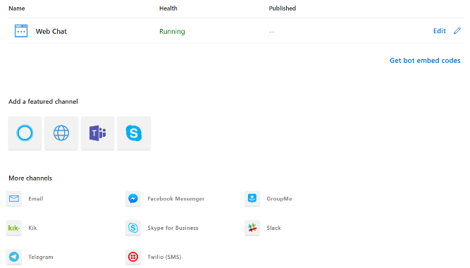
Channel Connectors
Notes:
Ubiquitous communication channels
Bot authentication

Slide 21
Prompts
AttachmentPrompt
ChoicePrompt
ConfirmPrompt
DatetimePrompt
NumberPrompt
TextPrompt
Notes:
dialog stack; like modal windows - same issues
Replaced by waterfall paradigm

Slide 22
Rich Cards
Animation Card
Audio Card
Hero Card
Thumbnail Card
Receipt Card
Signin Card
Video Card
Adaptive Card
Open Format (JSON)
Native look & feel in host
Not supported on all hosts

Slide 23
Cognitive Services
LUIS
Train model
Send “utterance”
Receive intent & entities
Ludown
Dispatch Model
Multi-lingual
Text Analytics
Sentiment Analysis
Language Detection
Key Phrase Extraction
Identify Entities (preview)
Notes:
Don’t overuse
Non-technical users can train/change models

Slide 24
Other Features
Conversation Starter
Learn from example conversations
Interactive teaching
Project Personality Chat (experimental)
Professional/Friendly/Humorous
Small talk for your bot
Proactive messaging
Timer/reminder/alert/long running operations
Maintain session/context

Slide 25
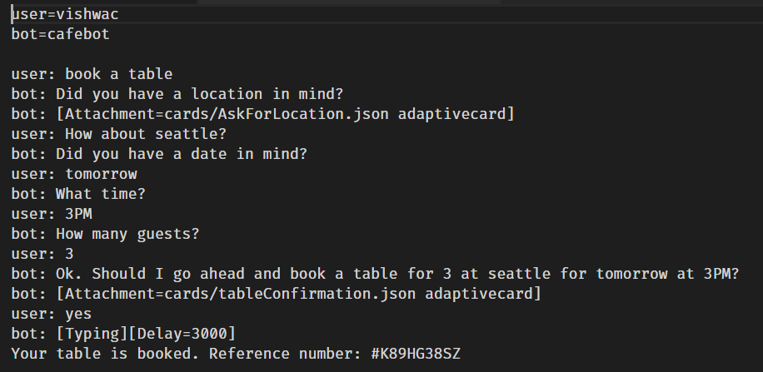
Chatdown

Slide 26
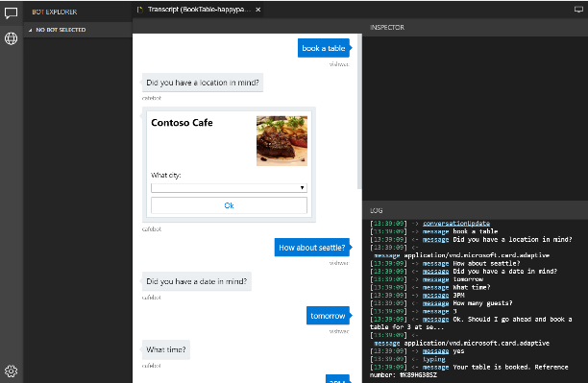
Bot Framework Emulator
Notes:
Electron app (like VS Code, Azure Storage Explorer, SQL Operations Studio)

Slide 27
Development
Visual Studio
VSIX Template
VS Code
Yeoman Generator
QnA Maker
Create Azure service
Create knowledgebase from file(s) or URL(s)
Azure Portal
Start in the portal (wizard) then download the project
C#/Javascript (stable)
Java/Python (prerelease)
Azure CLI (new – has some rough edges)
Notes:
yo botbuilder

Slide 28
Deployment
Web App
Function App
Bot Channel Registration
Azure CLI (new – has some rough edges)
MSBot CLI (new – has some rough edges)
Compliance Certifications (Bot Service hosted)
SOC
ISO 27001
ISO 27018
PCI
HIPAA
GDPR
Notes:
Az CLI can add channels

Slide 29
Wrap Up
A Bot Framework bot is just a web app (API actually)
Supports multiple languages
Use cognitive services to add smarts
Use your preferred toolchain
Use your preferred language
Deploy to your preferred cloud/host
The Bot Framework is plumbing
Now go build some bots!!!

Slide 30
Resources
aka.ms/botframework
botmakers.slack.com
luis.ai
qnamaker.ai
adaptivecards.io
Additional Sessions:
Fri 9:40am – Patterns for Building a Chatbot that Doesn’t Suck (Stephen Bohlen)

Slide 31
Questions?
Matt Burleigh
Email: mburleigh@outlook.com
Twitter: @svdreamline

Slide 32
Thank you!

